Slide 1


Social Buzz Data Insight

Slide 2


Today's agenda
Project recap
Problem
The Analytics team
Process
Insights
Summary

Slide 3

Social Buzz is a fast-growing technology, they want to learn data best practices from a large corporation. Due to the nature of their business, they have a massive amount of data so they are keen on understanding how the world's biggest companies manage the challenges of big data. Accenture is running a 3-month POC and we are focusing on the following:
- An audit of their big data practice
- Recommendations for a successful IPO
- An analysis of their content categories that highlight the top 5 categories with the
largest aggregate popularity
Project Recap

Slide 4

Problem
Every day over 100,000 pieces of content, ranging
from text, images, videos and GIFs are posted
Finding Social Buzz top five most popular categories on content

Slide 5



Andrew Fleming
Chief Technical Architect
The Analytics team
Marcus Rompton
Senior Principle
Tolulope Olarewaju
Data Analyst

Slide 6
Process
1
Data Understanding
2
Data Cleaning
3
Data Modelling
4
Data Analysis
5
Uncovering Insights

Slide 7

Insights

Slide 8
There are 16 unique categories with a total reaction score of 973,645

Slide 9
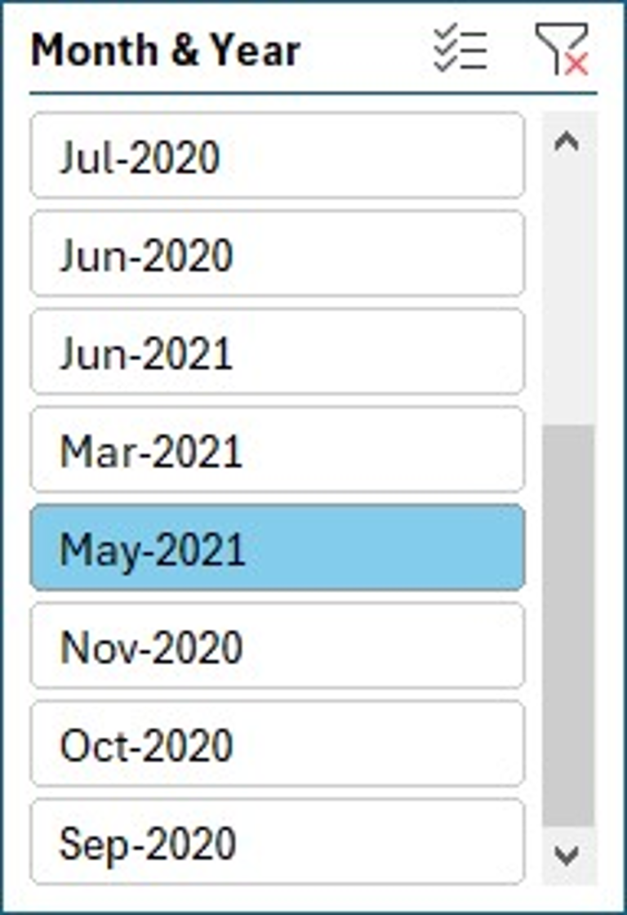

Slide 10

There are 16 unique categories.
May 2021 has the most posts. The Animals category had the highest total score of 7377 this month.
The five most popular categories are Animals, Science, Health Eating, Technology, and Food.
People are attracted to food and healthy eating, so you should partner with brands in this niche.
Technology is also an attractive category.
Summary

Slide 11
Thank you!
ANY QUESTIONS?

